Slide 1







Applied Data Science Capstone
Marcelo Almeida Gomes
22/12/2022

Slide 2



OUTLINE
Executive Summary
Introduction
Methodology
Results
Visualization – Charts
Dashboard
Discussion
Findings & Implications
Conclusion
Appendix

Slide 3

EXECUTIVE SUMMARY
Capstone Introduction
Data Collection
Data Collection API
Data Collection with Web scraping
Data Wrangling
Exploratory Data Analysis with Python
EDA using SQL
EDA using Pandas and Matplotlib
Interactive Visual and Dashboard
Predictive Analysis with Machine Learning
Conclusions

Slide 4

INTRODUCTION
SpaceX publishes rocket launches on its website
The launches are very expensive
SpaceX can launch with a cost of $62 MM, less than other providers because can reuse first stage
The job consists to determine
If the first stage will land successfully
Cost of a launch
To answers theses questions was necessary to gather information, creating dashboards and training a machine learning model

Slide 5

METHODOLOGY
Data Extraction
Data Preparation
Exploratory Data Analysis
Machine Learning Model
Training
Evaluation
Validation
Analysis of Results

Slide 6






METHODOLOGY - PIPELINE
5 - Deployment
1 - Data Extraction
2 – Data Preparing
3 – Data Analysis
4 – Model Training

Slide 7


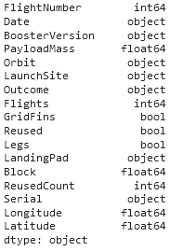
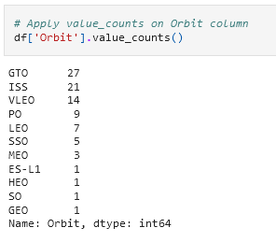
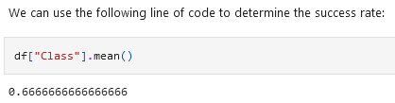

METHODOLOGY – COLLECTION AND WRANGLING
Data Collection from web¹ using BeautifulSoup lib from Python
Create a DataFrame using Pandas
Data Wrangling using Pandas and Numpy
1 https://en.wikipedia.org/wiki/List_of_Falcon\_9\_and_Falcon_Heavy_launches

Slide 8
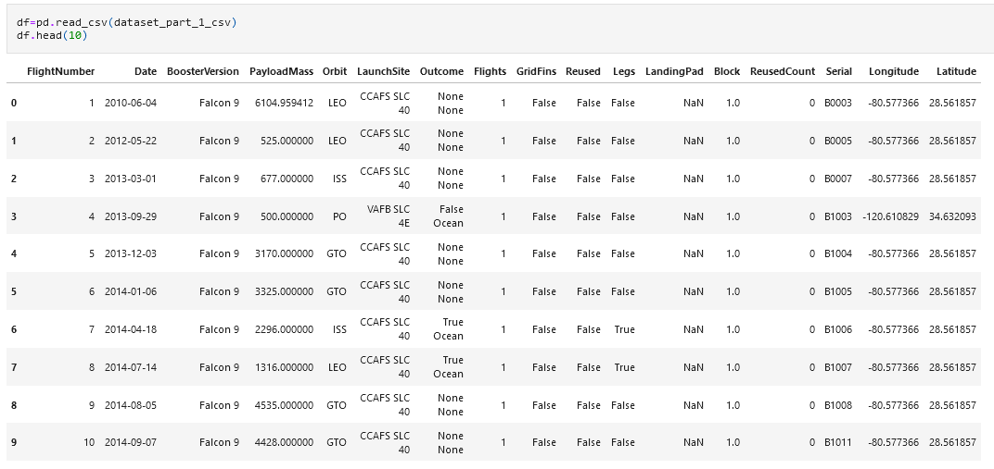
METHODOLOGY – CREATE DATAFRAME

Slide 9






METHODOLOGY – EDA
First Exploratory Data Analysis (EDA) using Matplotlib and Seaborn libs
Using SQL to some Analysis
Iterative Dashboard with Plotly and Dash
Map analysis with Folium

Slide 10
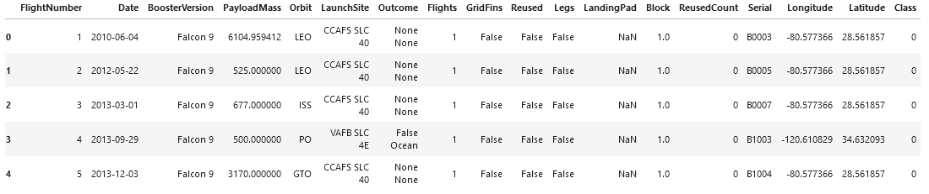
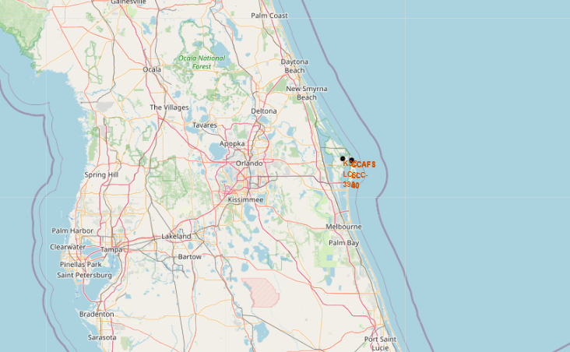
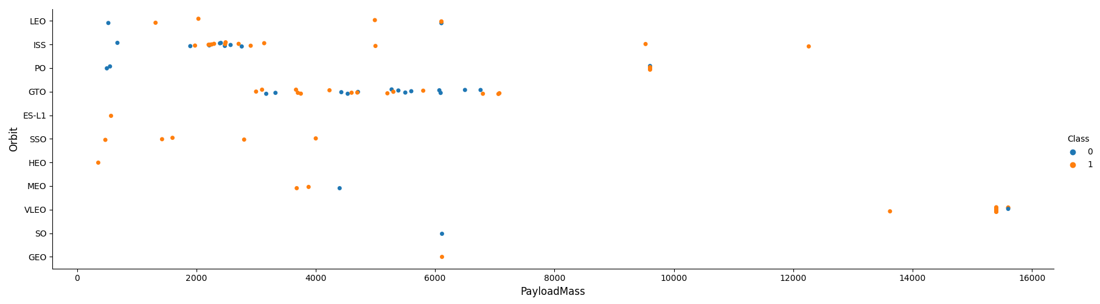
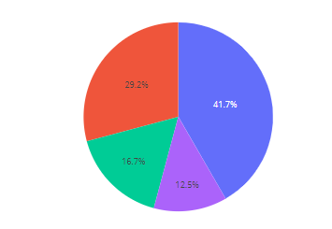
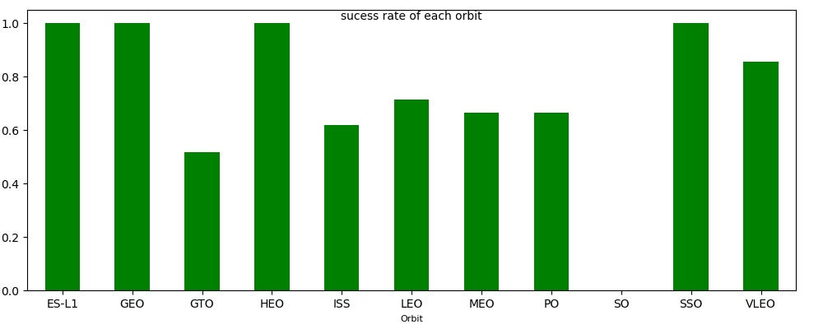
METHODOLOGY – EDA
Exploratory Data Analysis with tables, scatter, maps, bar, pie charts to make findings
See correlation between variables, counts total, per group and percent

Slide 11

METHODOLOGY – PREDICTIVE ANALYSIS
How we want to predict whether the launch will be successful the classification algorithms in machine learning was selected
This is a problem that target attribute is a categorical variable, class can be 0 if launch failed or 1 if successful
The classification models applied
Logistic Regression
SVM
Decision Tree Classifier
KNN
Use Scikit Learn to build, training, test and validate the model
The set to data test was 0.2 and then data train 0.8
Then find the method with best performs
The Accuracy was used to find method which performs best

Slide 12
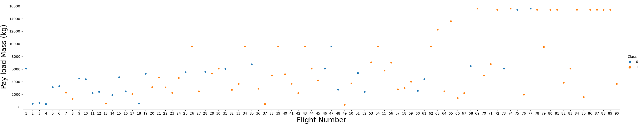
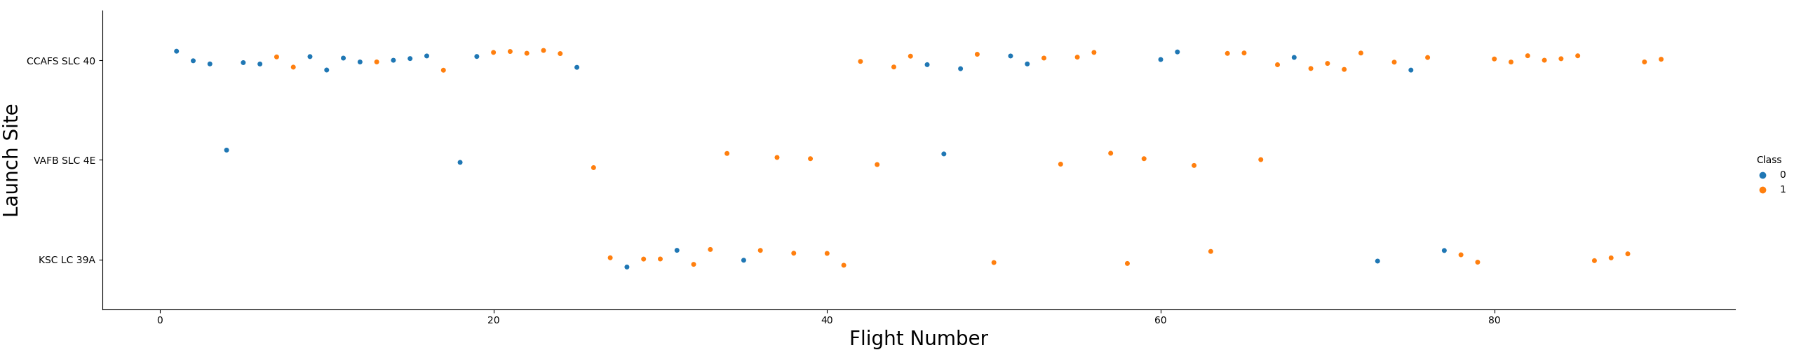
RESULTS – EDA
Relation between FlightNumber vs PayLoad and FlightNumber vs Launch Site

Slide 13
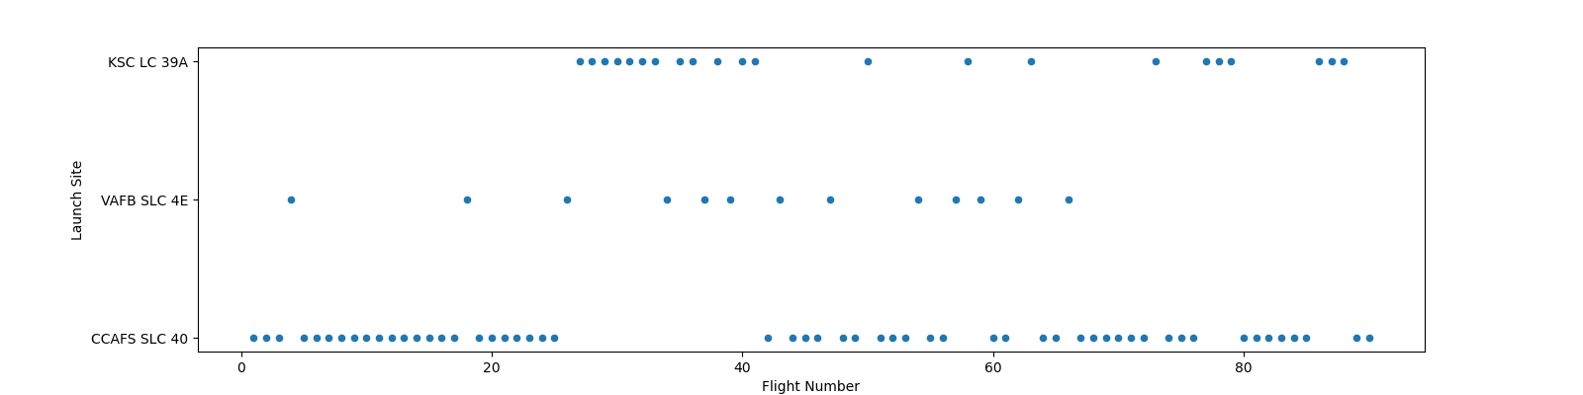
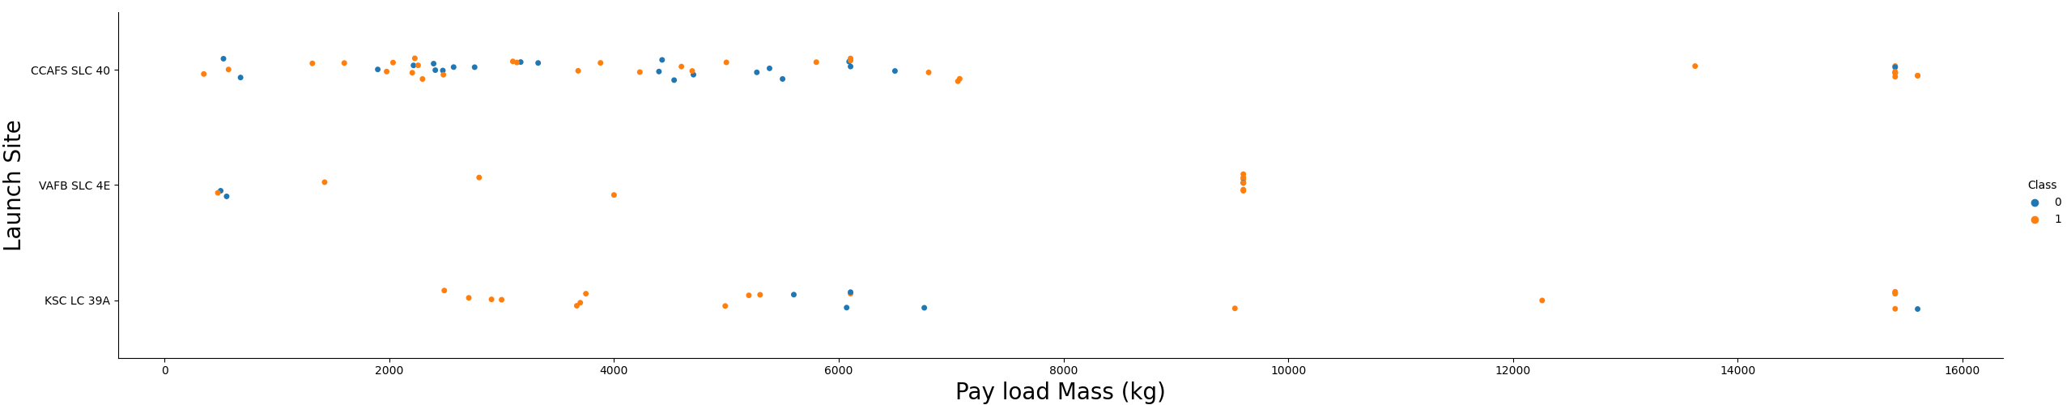
RESULTS – EDA
Relation between FlightNumber vs FlightNumber with scatter plot and PayLoad vs Launch Site

Slide 14
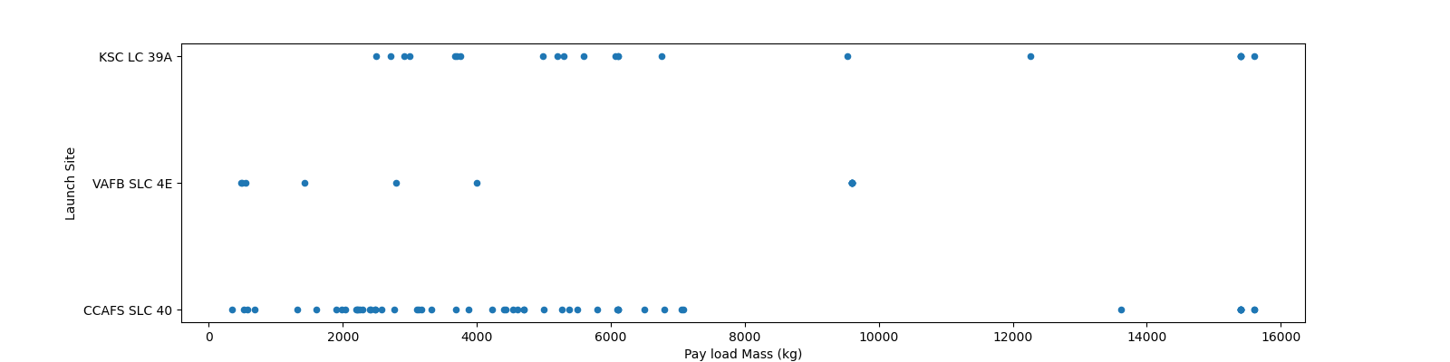
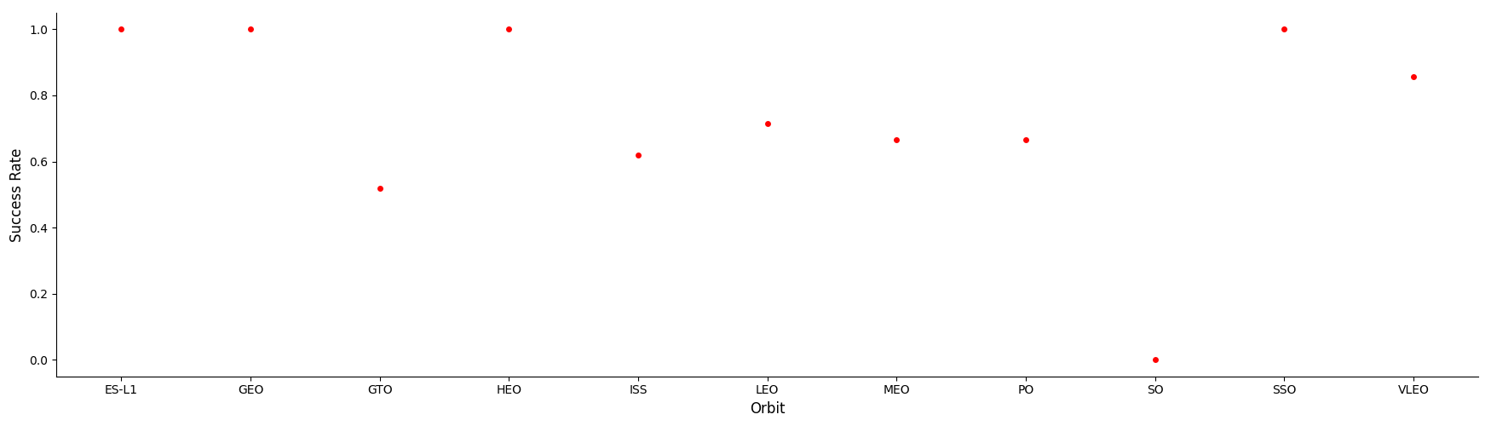
RESULTS – EDA
Relation between PayLoad vs Launch Site with scatter plot and Orbit vs Success Rate

Slide 15
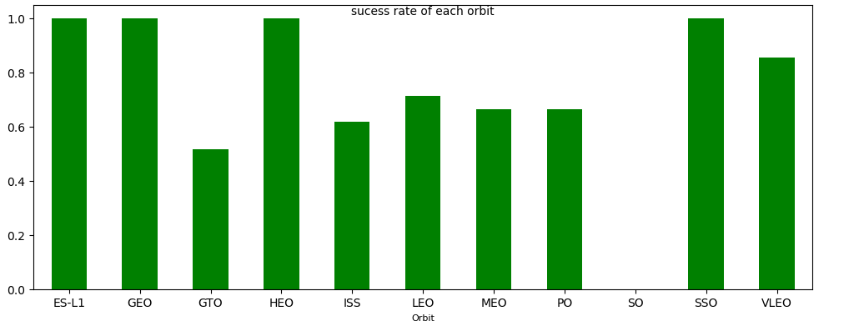
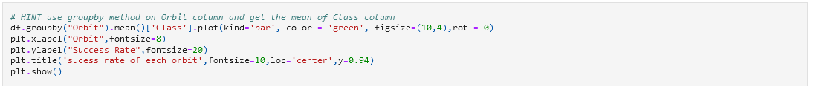
RESULTS – EDA
Bar graph showing Success Rate of each orbit

Slide 16
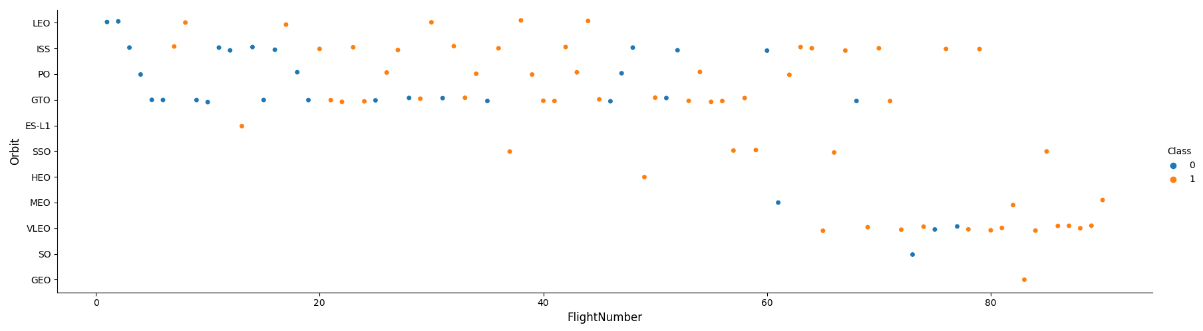
RESULTS – EDA
Relation between FligthNumber vs Orbit and PayloadMass vs Orbit

Slide 17
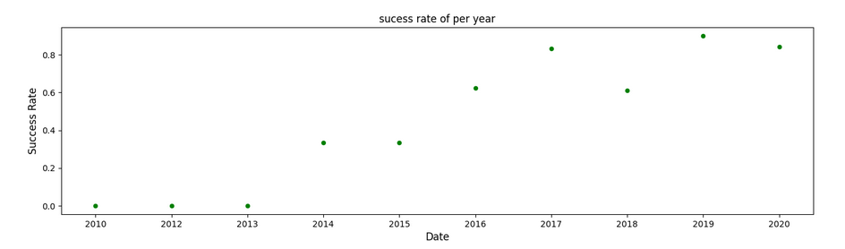
RESULTS – EDA
Relation between Success Rate vs Year
It’s show that the success rate increasing since 2013 till 2020

Slide 18
RESULTS – EDA
Relation between Success Rate vs Year
It’s show that the success rate increasing since 2013 till 2020

Slide 19
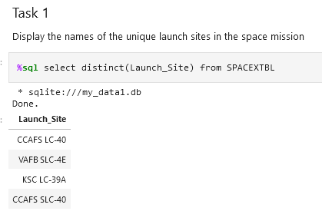
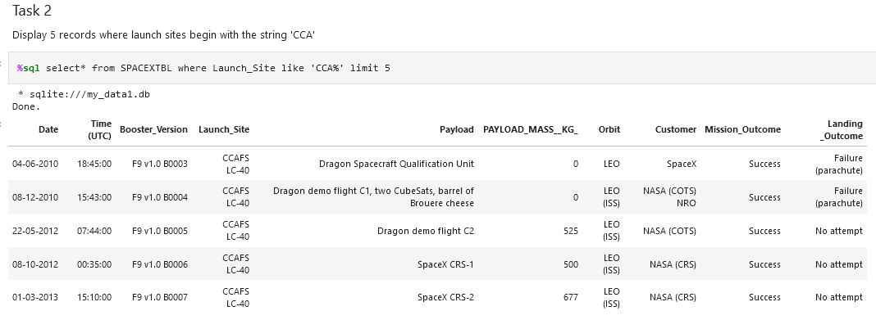
RESULTS – SQL

Slide 20
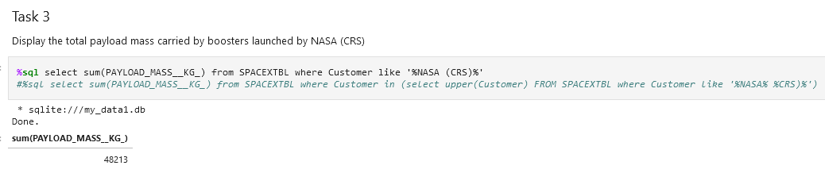
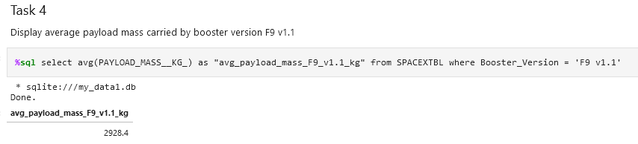
RESULTS – SQL

Slide 21
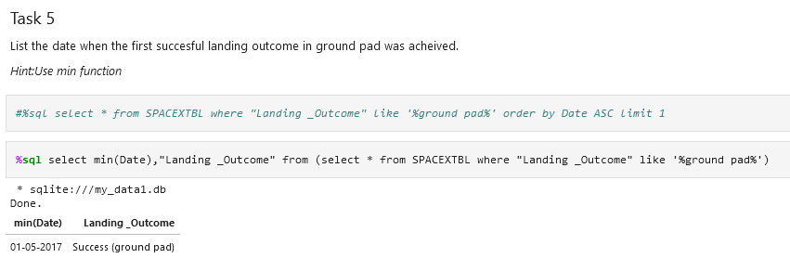
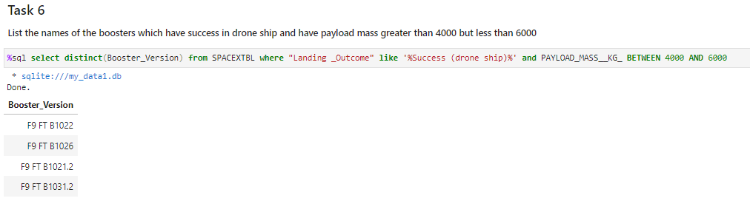
RESULTS – SQL

Slide 22
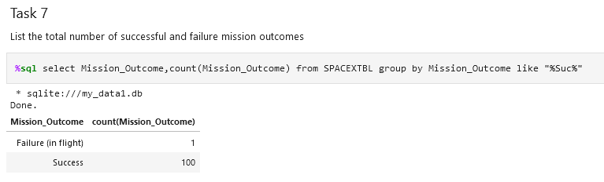
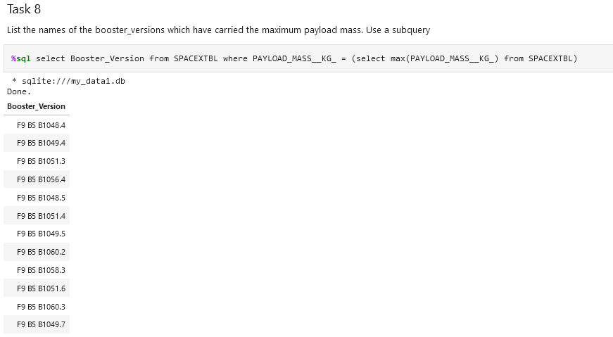
RESULTS – SQL

Slide 23
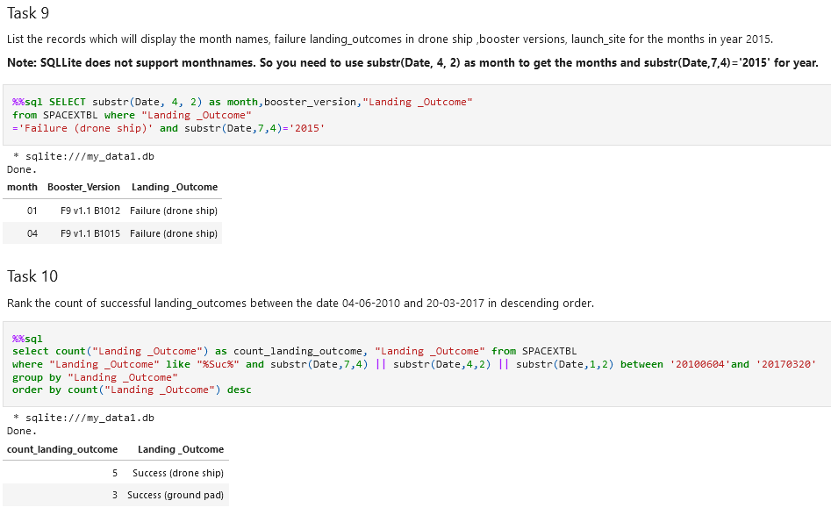
RESULTS – SQL

Slide 24
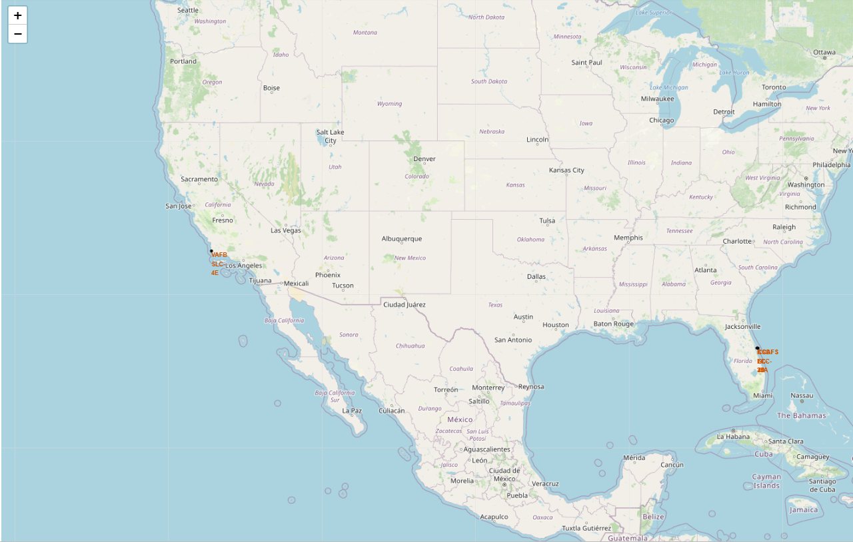
RESULTS – INTERACTIVE MAP

Slide 25
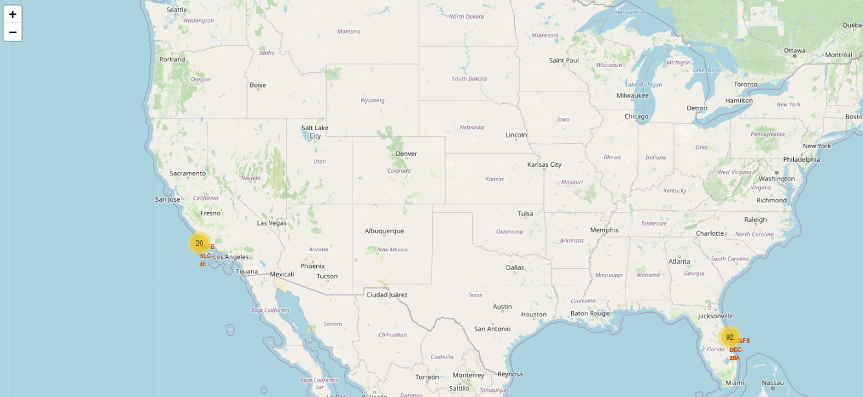
RESULTS – INTERACTIVE MAP

Slide 26
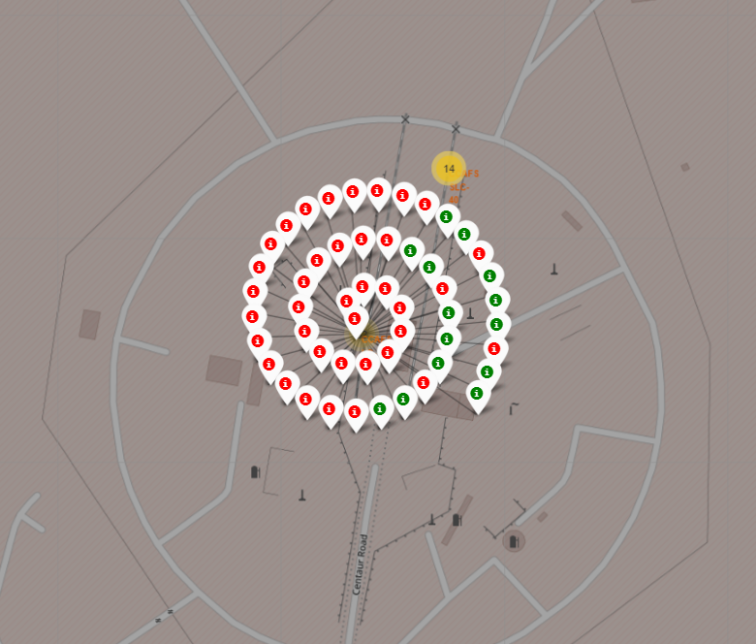
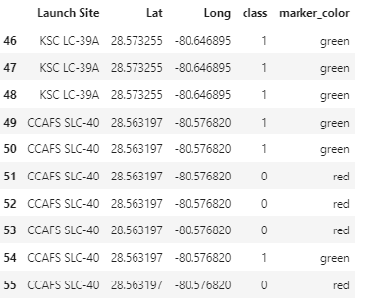
RESULTS – INTERACTIVE MAP

Slide 27
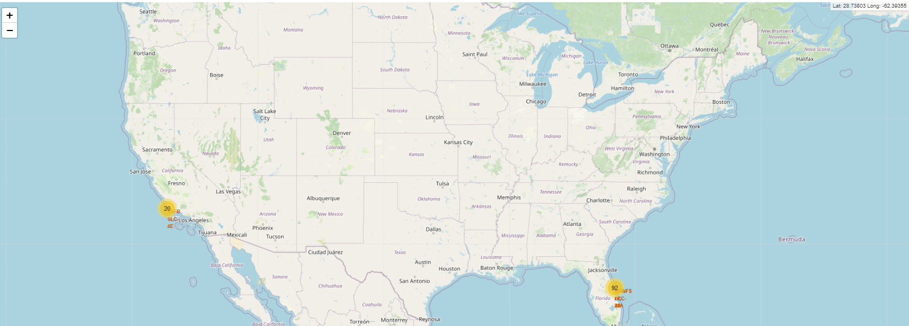
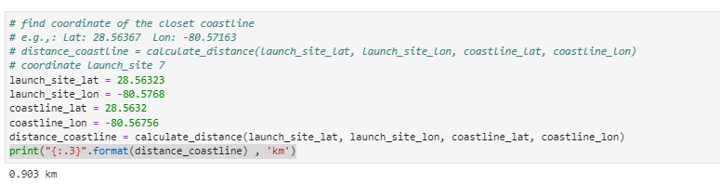
RESULTS – INTERACTIVE MAP

Slide 28
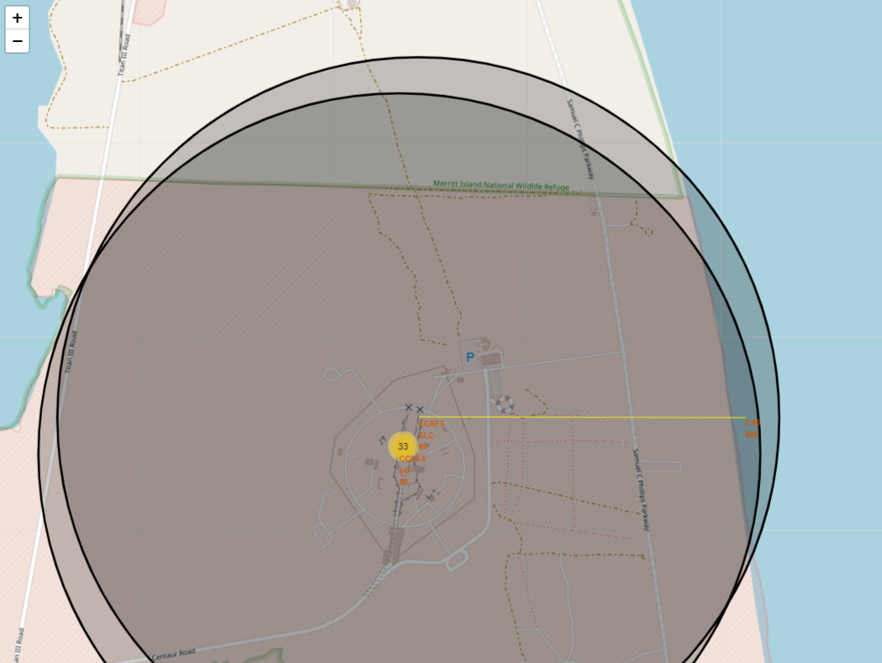
RESULTS – INTERACTIVE MAP

Slide 29
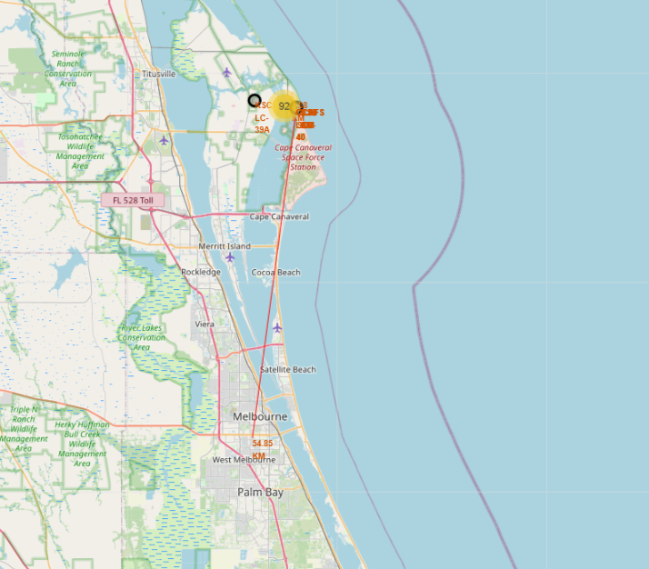
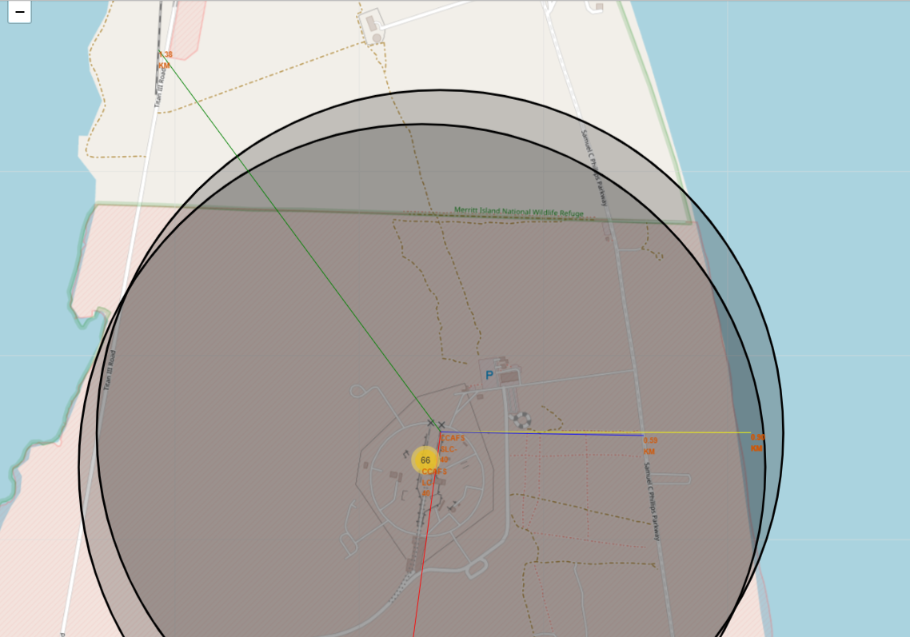
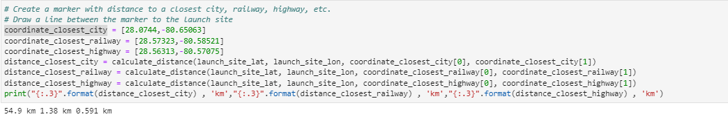
RESULTS – INTERACTIVE MAP

Slide 30
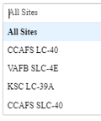
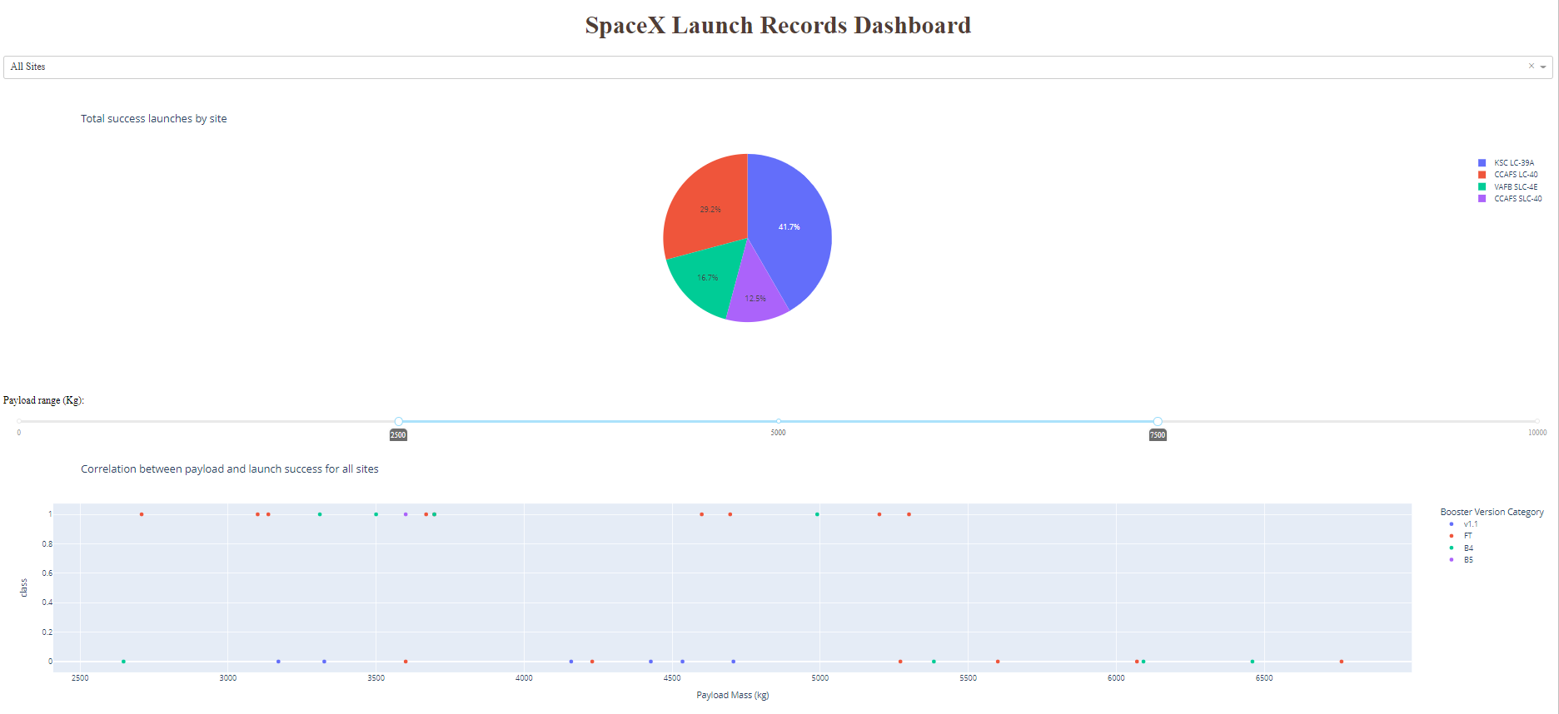
RESULTS – DASHBOARD
Options
Relation between Success Rate vs Year
It’s show that the success rate increasing since 2013 till 2020

Slide 31
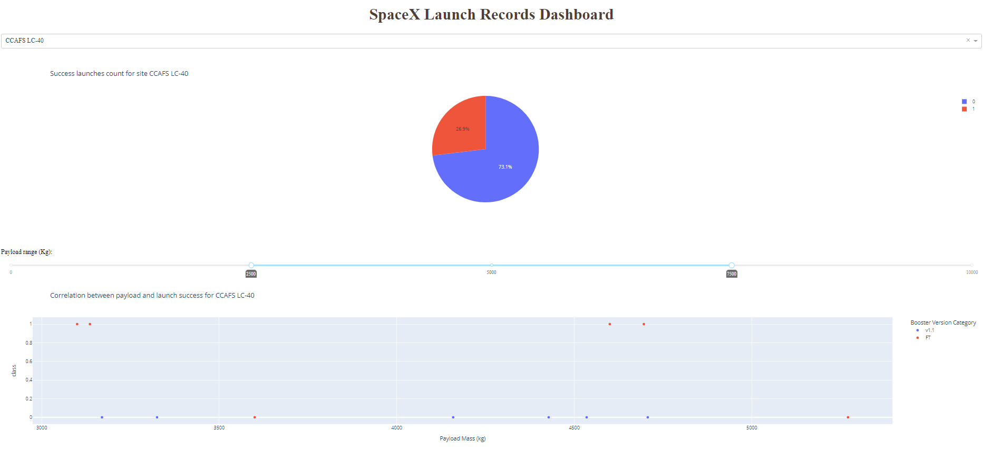
RESULTS – DASHBOARD

Slide 32
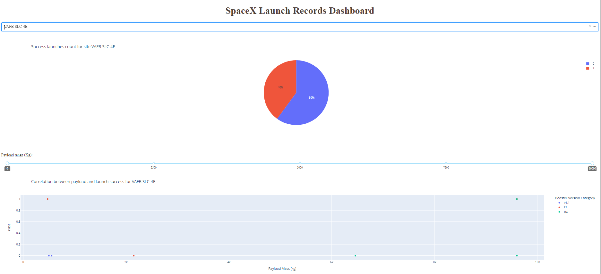
RESULTS – DASHBOARD

Slide 33
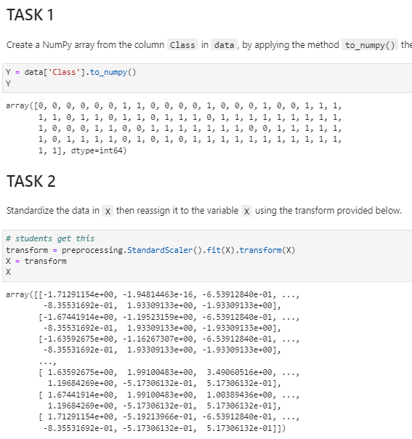
RESULTS – PREDICTIVE ANALYSIS

Slide 34
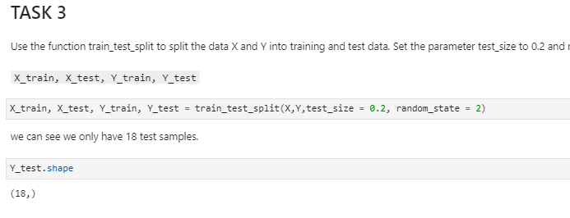
RESULTS – PREDICTIVE ANALYSIS

Slide 35
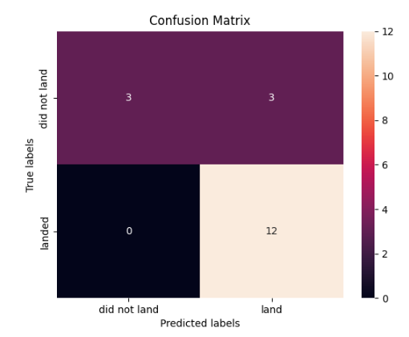
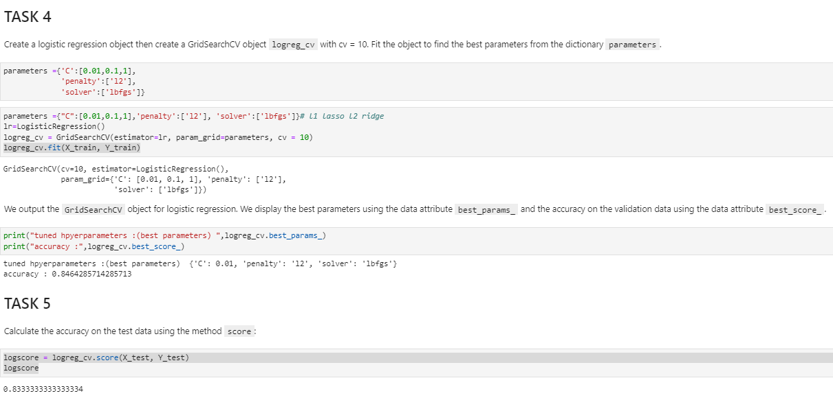
RESULTS – PREDICTIVE ANALYSIS

Slide 36
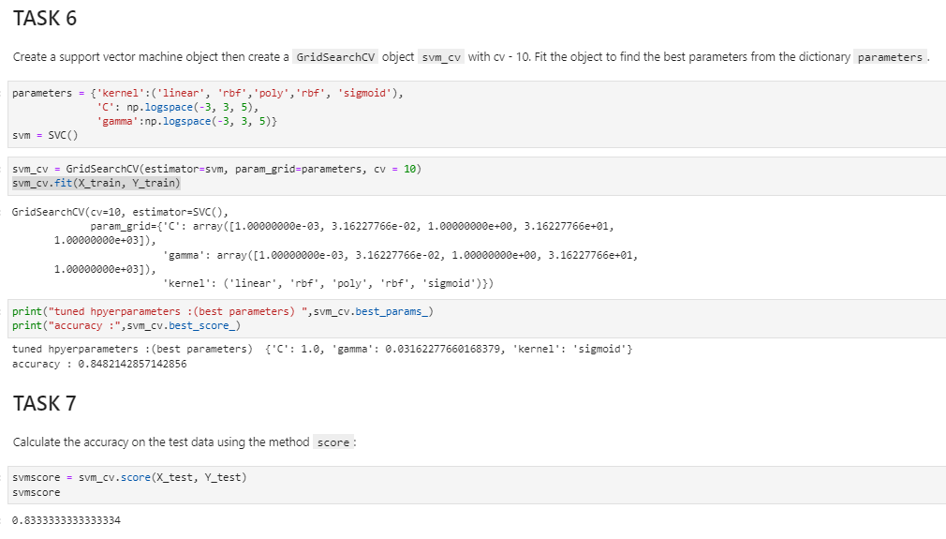
RESULTS – PREDICTIVE ANALYSIS

Slide 37
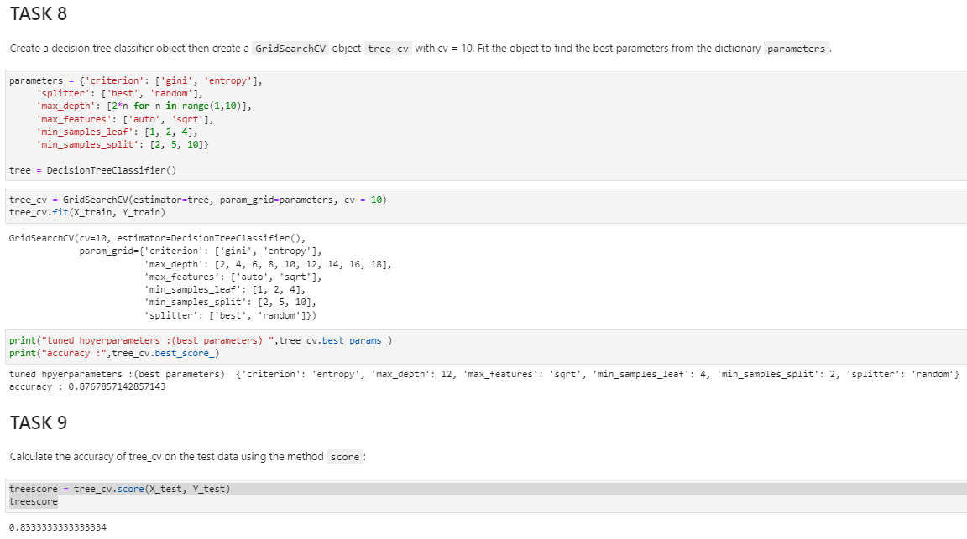
RESULTS – PREDICTIVE ANALYSIS

Slide 38
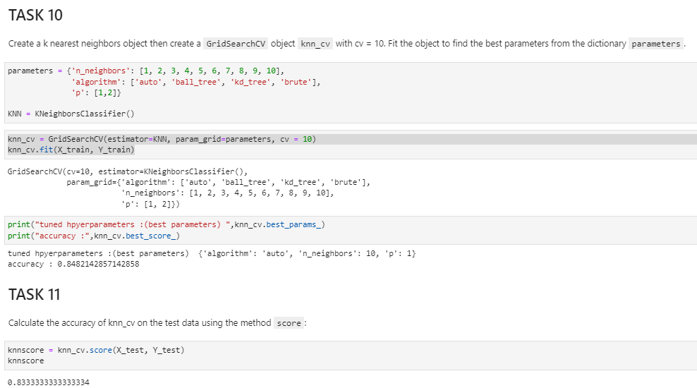
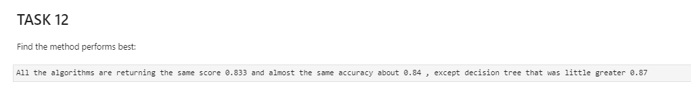
RESULTS – PREDICTIVE ANALYSIS

Slide 39


INOVATIVE INSIGTHS
Findings
KSC LC-39A has a good rate of success 76.9% and there is no fail to payload mass lower than 5.600 kg
Implications
Can be a good strategy choose more this launch site with payload less than 5.600 kg

Slide 40

INOVATIVE INSIGTHS
Findings
Based on confusion matrix It’s better using the model to predict successful than failed, and this is exactly what we want
Implications
It showed that model can be used to predict launch

Slide 41


INOVATIVE INSIGTHS
Findings
Maybe could be interesting available some meteorology data and another launch places in the world
Implications
It can give insights if there are some condition that improve the success rate and make a launch more safety and cheaper

Slide 42

CONCLUSION
Classification algorithm showed a good strategy to use to predict launch
The algorithm used in machine learning Logistic Regression, SVM, Decision Tree Classifier and KNN had the same score 0.833 and almost the same accuracy about 0.84, except Decision Tree that was little greater 0.87
These four algorithm can be used even decision tree had a little greater accuracy, but practically almost the same
SpaceX can use the model to help in decision and study the best strategy to launch. Then is possible to reduce risk off failed, accidents and reduce costs

